Slide 1
CSE4421/5324: Introduction to Robotics

Slide 2
Contact Information
Burton Ma
Lassonde 2046
burton@cse.yorku.ca
EECS4421/5324
lectures Monday, Wednesday, Friday 1:30-2:30PM (SLH C)
Lab 1 Thursday 12:30-2:30, Prism 1004
Lab 2 Thursday 2:30-4:30, Prism 1004
www.eecs.yorku.ca/course/4421
(web site not complete yet)

Slide 3
General Course Information
introduces the basic concepts of robotic manipulators and autonomous systems. After a review of some fundamental mathematics the course examines the mechanics and dynamics of robot arms, mobile robots, their sensors and algorithms for controlling them.

Slide 4
Textbook
no required textbook
first 6 weeks of course uses notation consistent with Robot Modeling and Control by MW Spong, S Hutchinson, M Vidyasagar

Slide 5
Assessment
labs/assignments 6 x 5%
midterm, 30%
exam, 40%

Slide 6
Introduction to manipulator kinematics

Slide 7
Robotic Manipulators
a robotic manipulator is a kinematic chain
  i.e. an assembly of pairs of rigid bodies that can move respect to one another via a mechanical constraint
the rigid bodies are called links
the mechanical constraints are called joints

Slide 8
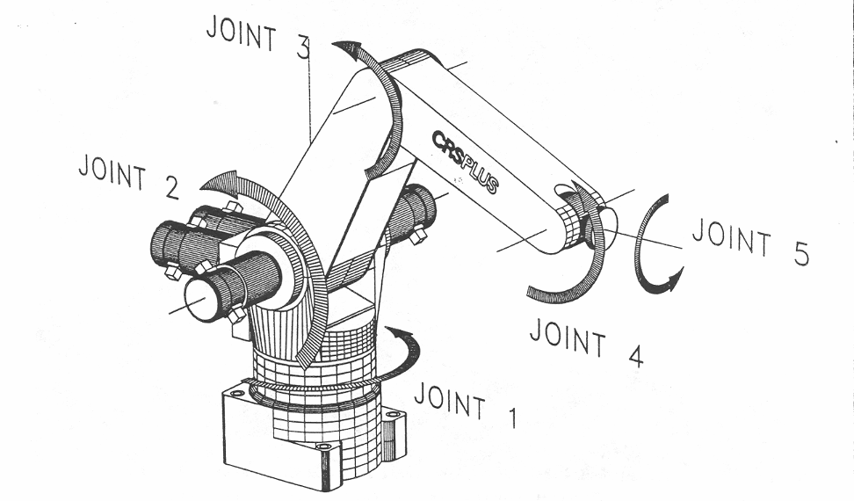
A150 Robotic Arm
link 3
link 2

Slide 9
Joints
most manipulator joints are one of two types
revolute (or rotary)
  like a hinge
prismatic (or linear)
  like a piston
our convention: joint i connects link i – 1 to link i
  when joint i is actuated, link i moves

Slide 10
Joint Variables
revolute and prismatic joints are one degree of freedom (DOF) joints; thus, they can be described using a single numeric value called a joint variable
q_{i} : joint variable for joint i
revolute
  q_{i} = θ_{i} : angle of rotation of link i relative to link i – 1
prismatic
  q_{i} = d_{i} : displacement of link i relative to link i – 1

Slide 11
Revolute Joint Variable
revolute
  like a hinge
  allows relative rotation about a fixed axis between two links
    axis of rotation is the z axis by convention
joint variable q_{i} = θ_{i} : angle of rotation of link i relative to link i – 1
link i
θ_{i}
link i – 1
joint i

Slide 12
Prismatic Joint Variable
prismatic
  like a piston
  allows relative translation along a fixed axis between two links
    axis of translation is the z axis by convention
  joint variable q_{i} = d_{i} : displacement of link i relative to link i – 1
link i – 1
link i
d_{i}
joint i

Slide 13
Common Manipulator Arrangments
most industrial manipulators have six or fewer joints
  the first three joints are the arm
  the remaining joints are the wrist
it is common to describe such manipulators using the joints of the arm
  R: revolute joint
  P: prismatic joint

Slide 14
Articulated Manipulator
RRR (first three joints are all revolute)
joint axes
  z₀ : waist
  z₁ : shoulder (perpendicular to z₀)
  z₂ : elbow (parallel to z₁)
z₀
z₁
z₂
θ₂
θ₃
shoulder
forearm
elbow
θ₁
waist

Slide 15
Spherical Manipulator
RRP
Stanford arm
  http://infolab.stanford.edu/pub/voy/museum/pictures/display/robots/IMG_2404ArmFrontPeekingOut.JPG
z₀
z₁
d₃
θ₂
shoulder
z₂
θ₁
waist

Slide 16
SCARA Manipulator
RRP
Selective Compliant Articulated Robot for Assembly
  http://www.robots.epson.com/products/g-series.htm
z₁
z₂
z₀
θ₂
d₃
θ₁

Slide 17
Parallel Robots
all of the preceding examples are examples of serial chains
  base (link 0) is connected to link 1 by a joint
  link 1 is connected to link 2 by a joint
  link 2 is connected to link 3 by a joint ... and so on
a parallel robot is formed by connecting two or more serial chains
  https://www.youtube.com/watch?v=p1Lrz0gPvOA

Slide 18
Forward Kinematics
given the joint variables and dimensions of the links what is the position and orientation of the end effector?
a₂
θ₂
a₁
θ₁

Slide 19
Forward Kinematics
choose the base coordinate frame of the robot
  we want (x, y) to be expressed in this frame
(x, y) ?
a₂
θ₂
y₀
a₁
θ₁
x₀

Slide 20
Forward Kinematics
notice that link 1 moves in a circle centered on the base frame origin
(x, y) ?
a₂
θ₂
y₀
a₁
θ₁
( a₁ cos θ₁ , a₁ sin θ₁ )
x₀

Slide 21
Forward Kinematics
choose a coordinate frame with origin located on joint 2 with the same orientation as the base frame
(x, y) ?
y₁
a₂
θ₂
y₀
θ₁
a₁
x₁
θ₁
( a₁ cos θ₁ , a₁ sin θ₁ )
x₀

Slide 22
Forward Kinematics
notice that link 2 moves in a circle centered on frame 1
(x, y) ?
y₁
a₂
( a₂ cos (θ₁ + θ₂),
a₂ sin (θ₁ + θ₂) )
θ₂
y₀
θ₁
a₁
x₁
θ₁
( a₁ cos θ₁ , a₁ sin θ₁ )
x₀

Slide 23
Forward Kinematics
because the base frame and frame 1 have the same orientation, we can sum the coordinates to find the position of the end effector in the base frame
(a₁ cos θ₁ + a₂ cos (θ₁ + θ₂),
a₁ sin θ₁ + a₂ sin (θ₁ + θ₂) )
y₁
a₂
( a₂ cos (θ₁ + θ₂),
a₂ sin (θ₁ + θ₂) )
θ₂
y₀
θ₁
a₁
x₁
θ₁
( a₁ cos θ₁ , a₁ sin θ₁ )
x₀

Slide 24
Forward Kinematics
we also want the orientation of frame 2 with respect to the base frame
  x₂ and y₂ expressed in terms
  of x₀ and y₀
y₂
x₂
a₂
θ₂
y₀
θ₁
a₁
θ₁
x₀

Slide 25
Forward Kinematics
without proof I claim:
x₂ = (cos (θ₁ + θ₂),
sin (θ₁ + θ₂) )
y₂
x₂
y₂ = (-sin (θ₁ + θ₂),
cos (θ₁ + θ₂) )
a₂
θ₂
y₀
θ₁
a₁
θ₁
x₀

Slide 26

Forward Kinematics
find $\left(x,y\right)$, $x_{2}$, and $y_{2}$ expressed in frame $0$
y₂
y₀
y₁
x₂
(x, y) ?
d₁
θ₂
x₀
x₁

Slide 27

Forward Kinematics
find $\left(x,y\right)$, $x_{2}$, and $y_{2}$ expressed in frame $0$
y₂
y₁
x₂
(x, y) ?
d₁
θ₂
y₀
x₁
$$30°$$
x₀

Slide 28
Inverse Kinematics
given the position (and possibly
the orientation) of the end
effector, and the dimensions
of the links, what are the joint
variables?
y₂
x₂
(x, y)
a₂
θ₂ ?
y₀
a₁
θ₁ ?
x₀

Slide 29
Inverse Kinematics
harder than forward kinematics because there is often more than one possible solution
(x, y)
a₂
y₀
a₁
x₀

Slide 30
Inverse Kinematics
law of cosines
(x, y)
a₂
b
θ₂ ?
y₀
a₁
x₀

Slide 31
Inverse Kinematics
and we have the trigonometric identity
therefore,
We could take the inverse cosine, but this gives only one of the two solutions.

Slide 32
Inverse Kinematics
Instead, use the two trigonometric identities:
to obtain
which yields both solutions for θ₂ . In many programming languages you would use the
four quadrant inverse tangent function atan2
c2 = (x*x + y*y – a1*a1 – a2*a2) / (2*a1*a2);
s2 = sqrt(1 – c2*c2);
theta21 = atan2(s2, c2);
theta22 = atan2(-s2, c2);

Slide 33
Inverse Kinematics
Exercise for the student: show that

Slide 34
Spatial Descriptions

Slide 35
Points and Vectors
point : a location in space
vector : magnitude (length) and direction between two points

Slide 36
Coordinate Frames
choosing a frame (a point and two perpendicular vectors of unit length) allows us to assign coordinates

Slide 37
Coordinate Frames
the coordinates change depending on the choice of frame

Slide 38
Dot Product
the dot product of two vectors

Slide 39
Vector Projection and Rejection
if u and v are unit vectors (have magnitude equal to 1) then the projection becomes
rejection of u from v
projection of u on v

Slide 40
Translation
suppose we are given o₁ expressed in {0}

Slide 41
Translation 1
the location of {1} expressed in {0}

Slide 42
Translation 1
the translation vector can be interpreted as the location of frame {j} expressed in frame {i}

Slide 43
Translation 2
a point expressed
in frame {1}
p¹ expressed in {0}

Slide 44
Translation 2
the translation vector can be interpreted as a coordinate transformation of a point from frame {j} to frame {i}

Slide 45
Translation 3
q⁰ expressed in {0}

Slide 46
Translation 3
the translation vector can be interpreted as an operator that takes a point and moves it to a new point in the same frame

Slide 47
Rotation
suppose that frame {1} is rotated relative to frame {0}

Slide 48
Rotation 1
the orientation of frame {1} expressed in {0}

Slide 49
Rotation 1
the rotation matrix can be interpreted as the orientation of frame {j} expressed in frame {i}

Slide 50
Rotation 2
p¹ expressed in {0}

Slide 51
Rotation 2
the rotation matrix can be interpreted as a coordinate transformation of a point from frame {j} to frame {i}

Slide 52
Rotation 3
q⁰ expressed in {0}

Slide 53
Rotation 3
the rotation matrix can be interpreted as an operator that takes a point and moves it to a new point in the same frame

Slide 54
Properties of Rotation Matrices
R^{T} = R⁻¹
the columns of R are mutually orthogonal
each column of R is a unit vector
det R = 1 (the determinant is equal to 1)

Slide 55
Rotation and Translation

Slide 56
Rotations in 3D

Slide 57
Rotations

Slide 58
Properties of Rotation Matrices
R^{T} = R⁻¹
the columns of R are mutually orthogonal
each column of R is a unit vector
det R = 1 (the determinant is equal to 1)

Slide 59
Rotations in 3D

Slide 60
Rotation About z-axis
+'ve rotation

Slide 61
Rotation About x-axis
+'ve rotation

Slide 62
Rotation About y-axis
+'ve rotation

Slide 63
Relative Orientation Example

Slide 64
Successive Rotations in Moving Frames
Suppose you perform a rotation in frame {0} to obtain {1}.
Then you perform a rotation in frame {1} to obtain {2}.
What is the orientation of {2} relative to {0}?

Slide 65
Successive Rotations in a Fixed Frame
Suppose you perform a rotation in frame {0} to obtain {1}.
Then you rotate {1} in frame {0} to obtain {2}.
What is the orientation of {2} relative to {0}?

Slide 66
Composition of Rotations
Given a fixed frame {0} and a current frame {1} and
  if {2} is obtained by a rotation R in the current frame {1} then use postmulitplication to obtain:
Given a fixed frame {0} and a frame {1} and
  if {2} is obtained by a rotation R in the fixed frame {0} then use premultiplication to obtain:

Slide 67
Rotation About a Unit Axis

Slide 68
Rigid Body Transformations

Slide 69
Homogeneous Representation
translation represented by a vector d
  vector addition
rotation represented by a matrix R
  matrix-matrix and matrix-vector multiplication
convenient to have a uniform representation of translation and rotation
  obviously vector addition will not work for rotation
  can we use matrix multiplication to represent translation?

Slide 70
Homogeneous Representation
consider moving a point p by a translation vector d
not possible as matrix-vector multiplication always leaves the origin unchanged

Slide 71
Homogeneous Representation
consider an augmented vector p_{h} and an augmented matrix D

Slide 72
Homogeneous Representation
the augmented form of a rotation matrix R_{3x3}

Slide 73
Rigid Body Transformations in 3D
{1}
{0}
{2}

Slide 74
Rigid Body Transformations in 3D
suppose {1} is a rotated and translated relative to {0}
what is the pose (the orientation and position) of {1} expressed in {0} ?
{1}
{0}

Slide 75
Rigid Body Transformations in 3D
suppose we use the moving frame interpretation (postmultiply transformation matrices)
  translate in {0} to get {0’}
  and then rotate in {0’} to get {1}
{0’}
{0}
{0’}
{1}
Step 1
{0}
Step 2

Slide 76
Rigid Body Transformations in 3D
suppose we use the fixed frame interpretation (premultiply transformation matrices)
  rotate in {0} to get {0’}
  and then translate in {0} in to get {1}
{0}
{0’}
{1}
Step 1
{0}
Step 2
{0’}

Slide 77
Rigid Body Transformations in 3D
both interpretations yield the same transformation

Slide 78
Homogeneous Representation
every rigid-body transformation can be represented as a rotation followed by a translation in the same frame
  as a 4x4 matrix
  where R is a 3x3 rotation matrix and d is a 3x1 translation vector

Slide 79
Homogeneous Representation
in some frame i
  points
  vectors

Slide 80
Inverse Transformation
the inverse of a transformation undoes the original transformation
  if
  then

Slide 81
Transform Equations
{2}
{1}
{0}
{4}
{3}

Slide 82
Transform Equations
give expressions for:

Slide 83
Transform Equations
{1}
{0}
{3}
{2}

Slide 84
Transform Equations
how can you find

